Slide 1

Now that Customers are taking Security Seriously, how does it affect us?
Salvin Naidoo
Notes:
Intro
Who am I
Why this topic – it is the new reality, and is here to stay. In my experience lots of people try to pretend that it doesn’t exist and even hope that it would just go away. That ship has pretty much sailed, but I also want to show people that it isn’t actually that bad if we accept it and try to make the necessary changes in the way we work, etc
I am illustrating my point of view a lot in here, particularly in relation to my own and our organization's experience.
I am not here to lecture anyone on security. I would rather hope that I give you a view into a space that you haven’t seen before, and do hope that I can inspire you to explore more on some of the things I will touch on.

Slide 2
Breaches Both home and abroad
Notes:
Why are we all so security aware today?

Slide 3


Recent Breaches
August 2013 | Yahoo, revealed December 2016 (3 billion records)
February 2017 | River City Media ( 1.3 Billion records)
January 2018 | Aadhaar system of the Unique Identification Authority of India(UIDAI) (1 billion records)
May 2016 | Myspace ( 427 million records)
October 2016 | Friend Finder Network Inc (412 million records)
December 2015 | US Voter Database (191 million records)
September 2013 | Adobe (152 million records)
March 2014 | eBay (145 million records)
May 2017 | Equifax, revealed September 2017 (143 million records)
June 2012 | LinkedIn, revealed May 2016 ( 117 million records )
June 2016 | VK (100 million records)
December 2014 | AOL (92 million records)
2017 | MyHeritage, revealed June 2018 ( 92 million records )
March 2018 | Facebook ( 87 million records )
October 2016 | Dailymotion ( 82.5 million records )
February 2015 | Anthem ( 80 million records )
December 2012 | Moroccans hack SA government
Jan 2012 | Postbank lost R 30 million
June 2016 | Standard Bank South Africa
July 2016 | Armscor
July 2016 | SABC website, as well as websites linked to the Gupta family
2016 | University of Limpopo
Dec 2016 and 2017 | KFC’s customer data were leaked
2017 | Old Mutual customer data breach
March 2017 | Ster-Kinekor
June 2017 | Buffalo City Municipality and Eastern Cape Education Department
November 2017 | Deeds Office leak
May 2018 | Viewfines
June 2018 | Liberty
This Photo by Unknown Author is licensed under CC BY-SA
Notes:
Notable ones – SA and US/world
What does this mean? People are finding lots of value in stealing data.
The range or scope is not limited to any particular sectors, it could be any industry, there is always some value to be gained.
Notably, SA also seems to have had some activist hacks as well
Who here has had their personal information exposed?
And what have you done about?

Slide 4
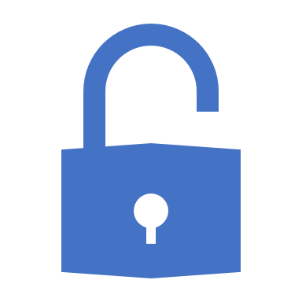
Attacker motivation
“As with physical security, the motivations for breaches of computer security vary between attackers. Some are thrill-seekers or vandals, some are activists, others are criminals looking for financial gain. State-sponsored attackers are now common and well resourced, but started with amateurs such as Markus Hess who hacked for the KGB, as recounted by Clifford Stoll, in The Cuckoo's Egg.”
https://en.wikipedia.org/wiki/Computer_security#Attacker_motivation
Notes:
Lots of different kind of people are doing this, there is no one profile of person
Also, patient and calculating
Not just looking for the uber hack any more
Baby steps
Chaining lots of vulnerabilities to gain entry
Selling information about vulnerabilities, not just data

Slide 5
Information security culture
What have we(CSG) seen in our world?
What are WBMS customers doing?
How do we treat security internally as a global corporate?
What are the impacts on internal processes – WBMS
What are the legislative impacts?

Slide 6
Changing Customer attitude
CSG customers are taking security seriously!!
Private security consultants scanning CSG provided software
Increased support issues regarding resolving discovered issues
Pre-sales increasingly having to fill out security questionnaires
Relating to known vulnerabilities and how they relate to our software
Also relating to OWASP practices and our software
Customers want to know how security exists in our processes
OWASP SAMM
Notes:
We know our customers are now taking this really seriously
Consultants
Our support issues in this space has spiked
Pre-sales are having to answer detailed questionnaires regarding known vulnerabilities and our internal security practices
Customers and more especially potential customers want to know what well known frameworks for secure development we have adopted

Slide 7
How do we treat Security internally?
Notes:
So what is CSG doing in this space particularly in Cape Town RnD

Slide 8
Security in CSG What are we doing?
Security focused team at a corporate level
RnD Security Lead
Logical in WBMS rather than physical
Organizational Training
Corporate Level
Mandatory online based training
Technical Architecture
External Training courses (CPUT)
OWASP SAMM
Evaluated our practices at points in time
Processes
Identified organizational gaps
Policies
Reworked security policies relating to License Software
Notes:
CSG has a Security focused team going all the way up the corporate chain
Influencing and working with each RnD shop in the organization
Promoting security
Pissing everyone off with all the security policies and requirements they are adding
Each Rnd shop in CSG has some sort of Secure Development Lead
Could be an individual or a group of them, in our case my team performs this role
Organizational Training
As a corporate CSG pushes lots of mandatory training to us
Over the past few years this has had a big focus on secure development and practices
This is great but it does not drive adoption of these practices and principles
My team (TA) has also gone through some external training at CPUT – French security consultancy
OWASP SAMM
The Open Web Application Security Project, an online community, produces freely-available articles, methodologies, documentation, tools, and technologies in the field of web application security.
SAMM (Software Assurance Maturity Model), framework to help organizations assess, formulate and implement a strategy for software security, which can be integrated into their existing Software Development lifecycle
Individuals in my team have been driving this to evaluate our internal practices and see where we can do better as well as determine where we are at a point in time.
Helped us and can definitely help you to give yourself a reference in terms of where you are right now, and will enable you to identify how you want to go forward based on what's important to your organization.
Current Processes
Stemming from our SAMM information and findings we have identified gaps in our processes and are actively determining and formulating advice on how to improve and make these processes better and more resilient
Internal Policies
Reworked some of our policies to align better with our(Licensed Software) products and how we interact with customers
CSG is a very diverse organization and provides services in a few different spaces in a few different models
Ongoing process of evaluation with OWASP SAMM
Security is not static
A computer lets you make more mistakes faster than any invention in human history - with the possible exceptions of handguns and tequila. — Mitch Ratliff

Slide 9
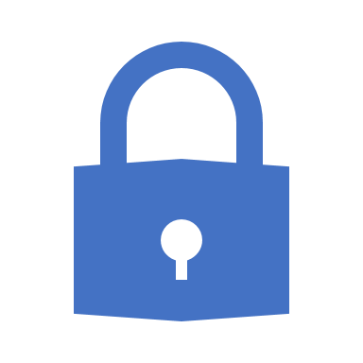
Security and Software Development
Secure by design
Security as a first class citizen
Team Focus on Security
Not just Developer Focused
Testing & Analysis just as important
Proactive Security Support
Support Policy must be security aware
Be aware of the Customer’s perspective
Reputational Damage
Responsible and ethical behavior
Notes:
In Software Development there are generally things that you should be aware of and practice
This is not an extensive list, but these are the things that I feel are quite important particularly from our own experience in CSG
Secure by Design
More an more it is becoming apparent that Security cannot be an afterthought. Just as the Privilege and Access control mechanisms need to be build into your software from the architecture inception stages, so does the notion of secure development practices and threat models that enable you to ensure you are taking the security of the running application(s) seriously
Team Focus on Security
Does not mean it’s the developers job. CSG has Scrum Teams, therefore we have collective ownership. This is a WIP for CSG, we are just at the beginning here. We are doing analysis and establishing our strategy
Analysis and Test must also be security aware. Both these disciplines have a key role to play in ensuring that robust software is delivered. Individuals in these spaces should ask themselves – “How can I champion secure development in my space” and be able to justify to themselves “Why it is important”
Proactive Security Support
Starting point is your policy here, if this isn’t explicit about how we deal with security in support it can become quite dangerous. Remember, unlike bugs in software functionality, security vulnerabilities can have sever consequences in terms of reputational damage as well as legislative penalties. This does not mean you MUST fix everything as fast as you can, it means you need to be ethical and responsible, and key people in your organization must take responsibility for decisions that are risky for the organization.
Customer Perspective
Segways in from previous point
Teams must be aware of potential Reputational Damage that can be incurred because of poor secure development practices. This does have an impact on not only them but also everyone else in the organization.
Also, it has become apparent looking at all the major security breaches, that legislators and customers care more about a vendor being ethical and responsible more than they would have us fix every vulnerability. Some times it is enough to inform a customer about a vulnerability even if we will not be providing a fix for it. This enables them to take any necessary steps they feel they need to take in order to protect themselves.

Slide 10
Legal issues and global regulation
GDPR
Well Defined legislation with lots of specifics
Defined penalties for compromise of user data
Defined Time Frames for communication
User privacy focused
Already in effect
POPI
In effect in the first 3 months of 2019
Similar yet not as specific as GDPR
Applicable to us In South Africa
Notes:
I’ve mentioned Legislation a few times now, but in terms of most of us here, the 2 mentioned on this slide are the ones we are most aware, probably.
GDPR(General Data Protection Regulation) has been a big hype in 2018, and justifiably so.
It is a well defined and quite specific legislation in many ways.
The significant aspect about it is that it has defined penalties that relate to an organizations revenue. As a software vendor, we need to be aware that our secure development practices or lack thereof can affect the profitability if not the existence of our customers, based on GDPR.
Is SA we have the POPI(Protection of Personal Information) Act. It is intended to come into full effect in 2019. Certain sections have been in effect from 2014. Compliance requirements have not really come into effect yet.
This will probably affect us all here, and it important that we all understands what it means to us, not just as individuals producing software, but as individuals whose data it is intended to protect.
In terms of CSG, we have spent lots of hours evaluating our software and processes against the requirements of GDPR, including training and workshops to staff. We are also auditing our internal environments, as well as building a framework to ensure this at a corporate legal level.

Slide 11
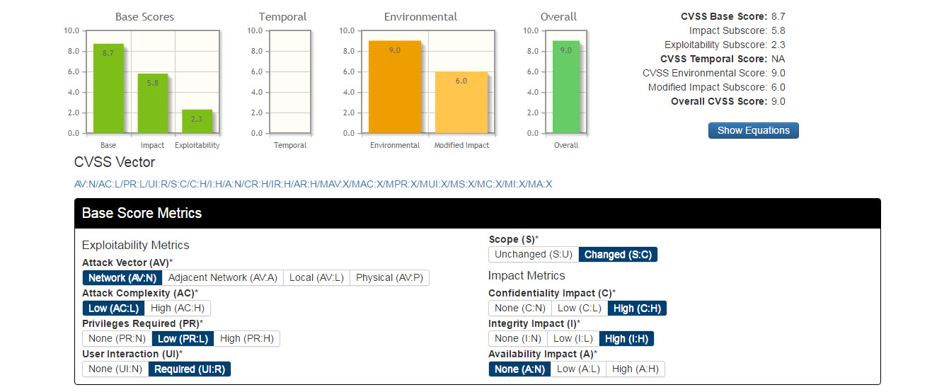
Speaking a common language
This Photo by Unknown Author is licensed under CC BY-SA
Notes:
What I’ve personally found when discussing security vulnerabilities, is that it’s really, really easy, to get into Circular Discussions with different individuals who have a different focus.
This can be (ok it is) very frustrating and isn’t constructive. This is why its important to find a way to communicate effectively with all stakeholders about vulnerabilities.
Our Work with OWASP SAMM and other research lead us to look into, and right now adopt CVSS( Common Vulnerability Scoring System ).
CVSS breaks up the analysis of a vulnerability into different areas of concern, and allows you to think about these areas in isolation.
What I find very useful as well is that when you speak to others in your organization or outside your organization, you are speaking in relatively clear metrics. Yes there could still be contentious scores for specific metrics, but as an aggregate it pretty much works. I have already used this effectively with communicating with both Product Management, and our customers.
Even within a development team, I personally believe using a tool like CVSS would be able to help teams communicate effectively with each other about vulnerabilities.

Slide 12

Looking Ahead
Delivery teams are going to have to be more security conscious in Analysis, Test and Design
Notes:
This is my view!!!

Slide 13
What does this mean for software testing?
More focus on security vulnerabilities and penetration testing
Upskilling on attack simulation
Upskilling on toolsets
Wireshark
Fiddler
OWASP ZAP
Add more here
Security a first class citizen in the testing world
Vulnerabilities are just another kind of defect
Notes:
This is what I believe we should be doing, eventually, based on what we know now.
This is the vision in my mind.
One thing we have found is that attack simulation is something we need lots of upskilling. Changing the way we think so that we can build effective Threat models will help this. There are opportunities here to not only improve in this space, but this is a space were we can build very valuable automation suites.
There are a lot of tools out there, and finding fun ways to get to know them is definitely possible. Just last month we had a hacking challenge at CSG in order to promote things like this.
Our mindset must be enhanced to treat Security as a First Class Citizen. Vulnerabilities should be seen as just another kind of defect and fit into our processes and policies as such. To paraphrase “Winter is coming”, legislation, security and privacy aware customers and awareness of ethical behavior of organizations, coupled with the bad actors’ increased desire, organization and readily available toolsets will make it very dangerous to continue to treat secure development as an afterthought.

Slide 14
Works cited
https://www.statista.com/statistics/290525/cyber-crime-biggest-online-data-breaches-worldwide/
https://www.groveis.com/blog/grove-mitigate-cyber-attacks-in-south-africa-mimecast-darktrace
Tools
https://www.wireshark.org/
https://www.telerik.com/fiddler
https://www.owasp.org/index.php/OWASP_Zed_Attack_Proxy_Project
https://tools.kali.org/tools-listing
Useful Learning Material
https://www.pluralsight.com/courses/hack-yourself-first
https://www.lynda.com/IT-Infrastructure-tutorials/Penetration-Testing-Advanced-Web-Testing/751330-2.html

Slide 15
More Questions
Go for it now, or sniff me out later

